Slide 1
Crop Yield Prediction-Programming for Data Analytics
CIS7031 - Programming for Data Analytics
Aaditya Vengatachalapathy
st20290358

Slide 2
Crop Yield Dataset
Predicting crop yields is a significant issue in agriculture. The main factors influencing agricultural production include weather (temperature, rain, etc.), pesticides, and precise historical crop yield data, which is crucial for decision-making regarding agricultural risk management and future projections. The elements that humans need to survive are comparable.
Although there are significant regional variations in cuisine, most basic human needs are met by a comparable set of components. We consume a lot of simple crops like corn, wheat, and rice. In this study, machine learning techniques are applied to anticipate the top 10 most consumed yields globally.

Slide 3
Analytical Question
(a) How reliably can machine learning regression models forecast the yield of the world's top ten most eaten crops using historical data and significant agricultural parameters including weather, pesticide use, and crop-specific characteristics?
(b) In what ways does the dataset's change in temperature and rainfall affect crop yields in different areas and crop types?

Slide 4
Gathering and Cleaning Data
The final dataset which is obtained is derived from series of different dataset such as rainfall dataset, pesticide dataset, temperature dataset and yield dataset. This is performed as gathering and cleaning data to obtain a final dataset which is being used for Exploratory Data Analysis. The dataset is being taken from Kaggle website.
Pesticide Dataset : https://www.kaggle.com/code/tipatle/crop-yield-prediction-data-integration/input?select=pesticides.csv
Rainfall Dataset : https://www.kaggle.com/code/tipatle/crop-yield-prediction-data-integration/input?select=rainfall.csv
Temperature Dataset : https://www.kaggle.com/code/tipatle/crop-yield-prediction-data-integration/input?select=temp.csv
Yield Dataset : https://www.kaggle.com/code/tipatle/crop-yield-prediction-data-integration/input?select=yield.csv
From all this datasets the important column is identified and those columns from all the dataset is being merged to obtain the final dataset that is named as yield_df.
Final Dataset : https://www.kaggle.com/code/tipatle/crop-yield-prediction-data-integration/input?select=yield_df.csv
The final dataset contains 28242 rows and 7 columns in total which meets the criteria of this Report.

Slide 5
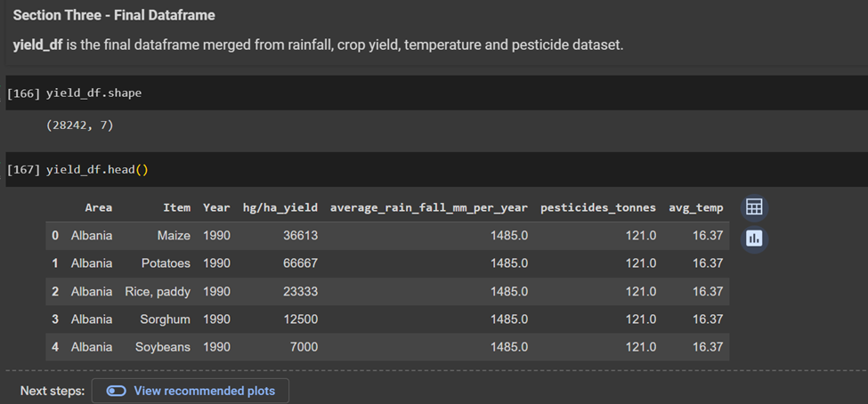
Final Dataframe - yield_df

Slide 6
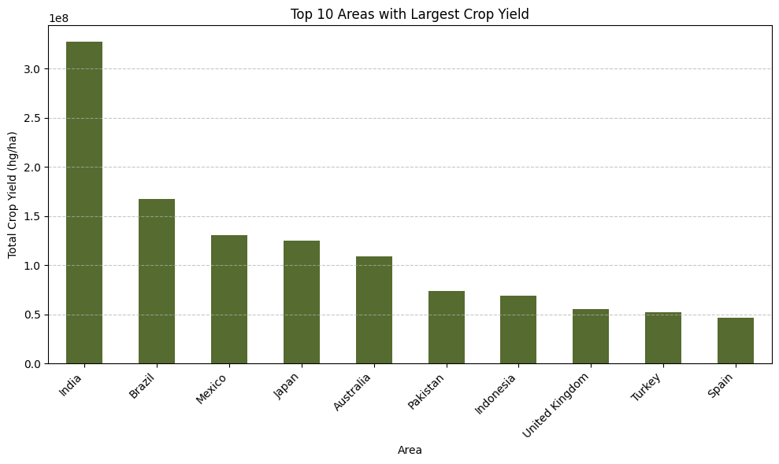
EDA - Visualization with Top 10 Areas with Large crop Yield

Slide 7
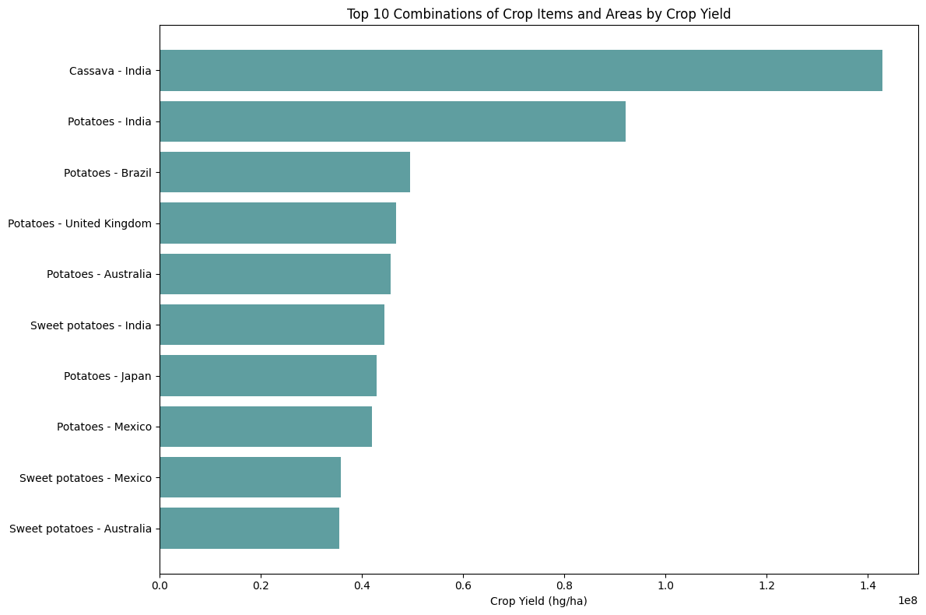
EDA - Visualization of Top 10 combinations of crop items and areas by crop yield.

Slide 8
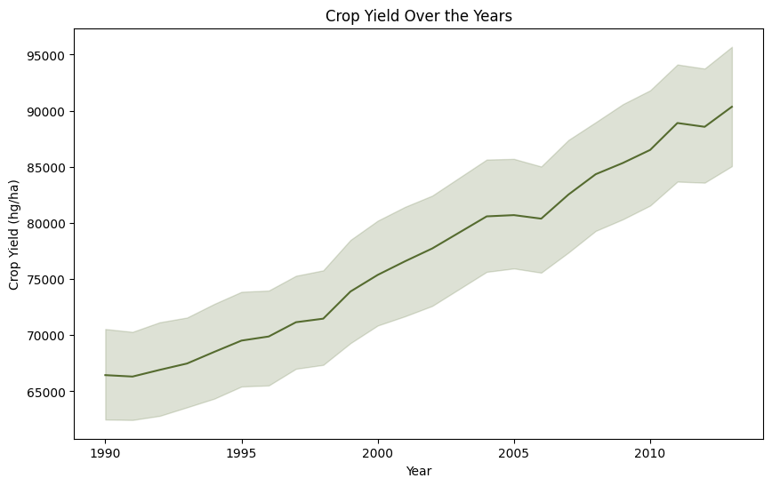
EDA - Visualization of crop yield over the years

Slide 9
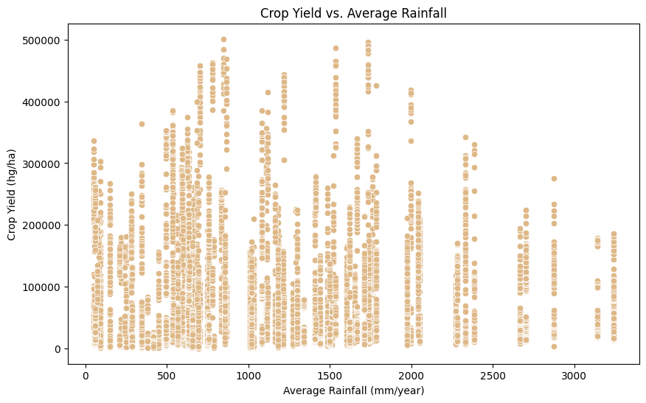
EDA - Visualization of crop yield with average rainfall.

Slide 10
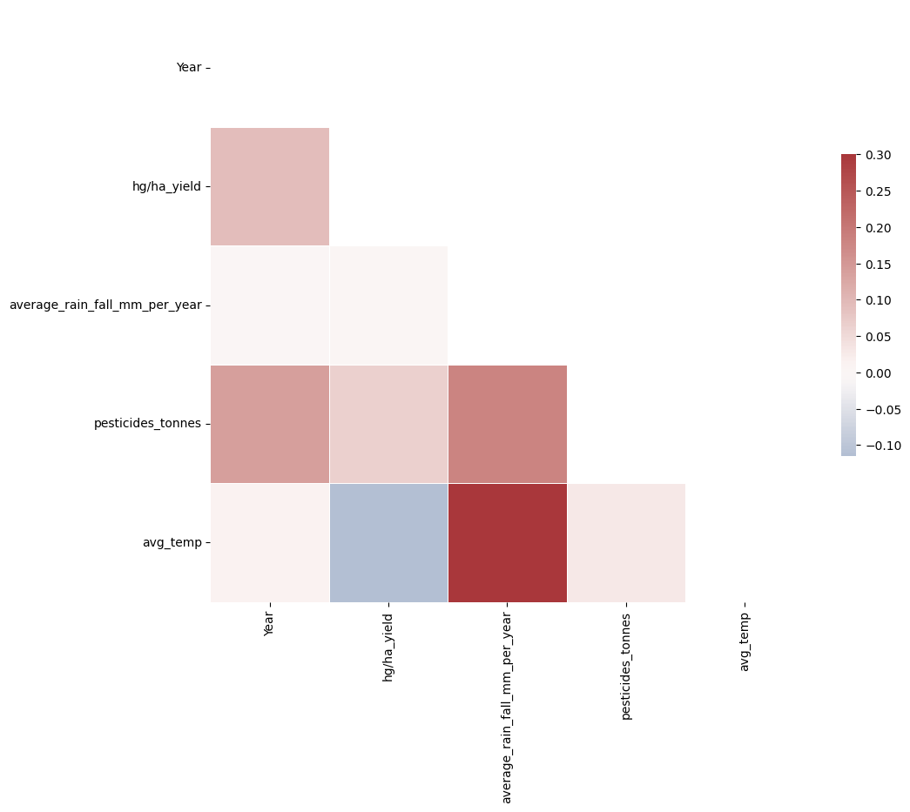
Correlation as Heatmap
Note : From above correlation heatmap it is found that there is no correlation between any of the columns of the dataframe.
Non-linear Relationships: The relationship between variables can be non-linear, which means that changes in one variable do not always correlate to changes in another in a linear fashion. Limited Variability: The variables in the dataset may not change enough to reveal meaningful associations. Identifying correlations can be difficult if the data is excessively uniform or lacking variation.

Slide 11
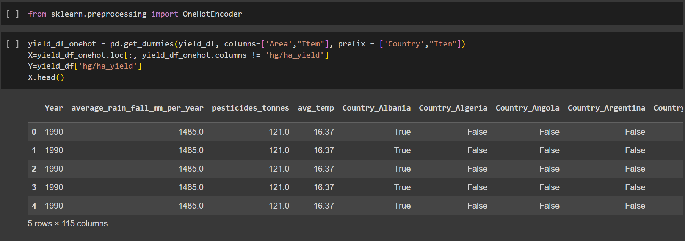
OneHot Encoder

Slide 12
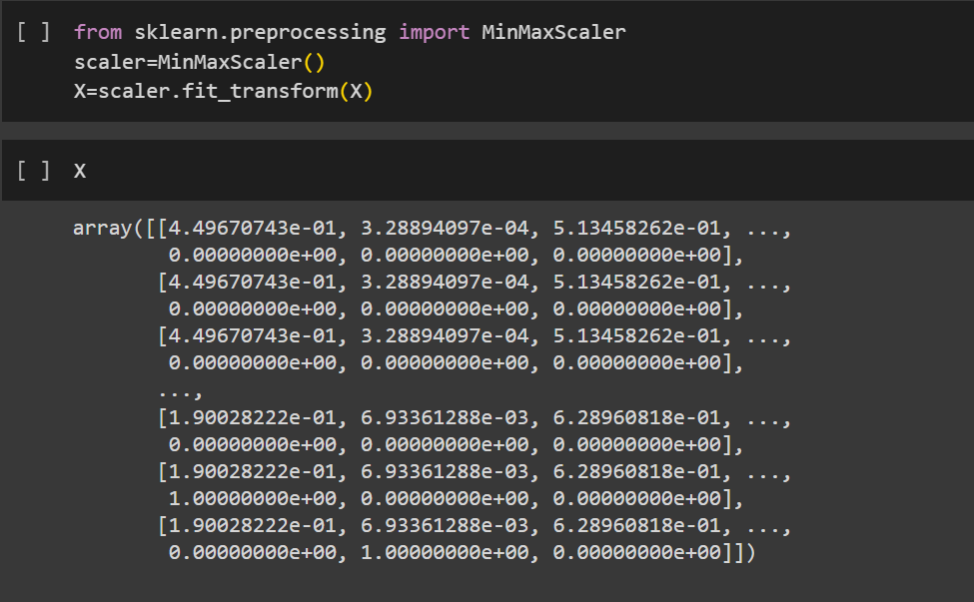
Normalization

Slide 13
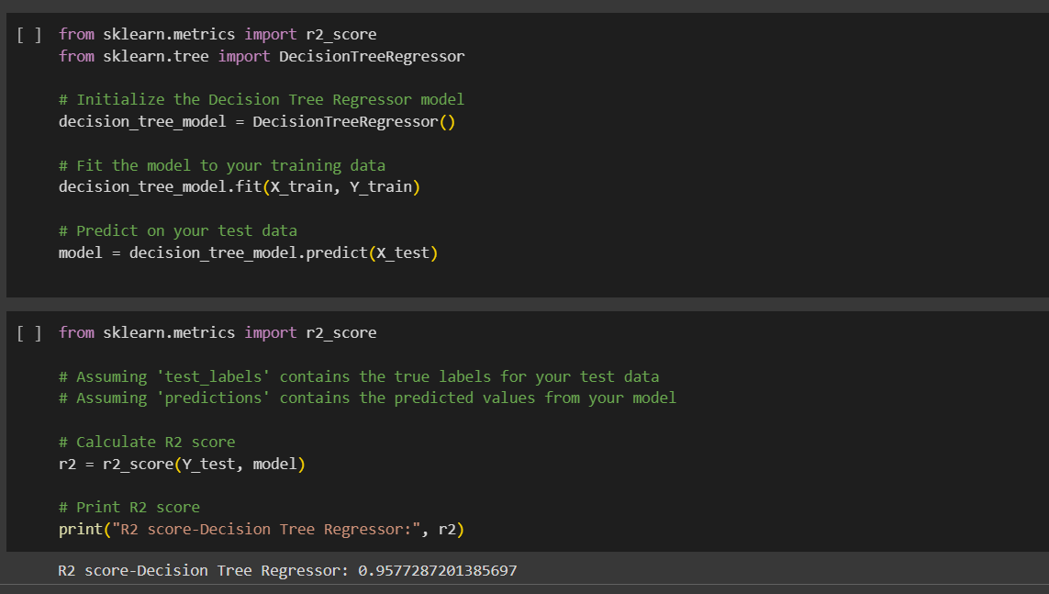
Model Selection

Slide 14
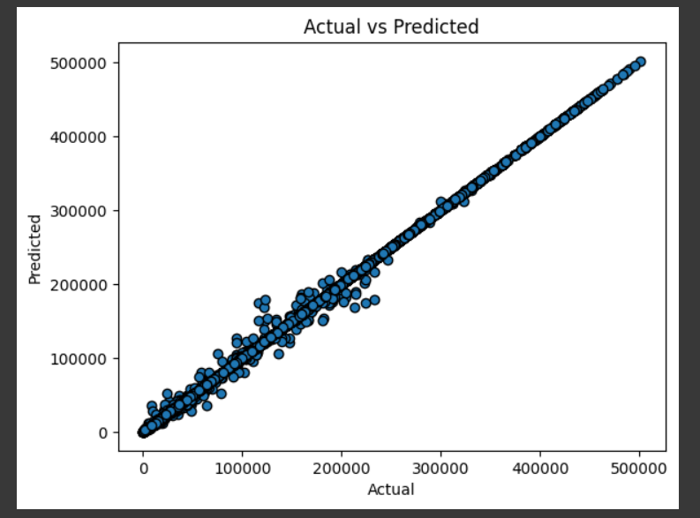
Key result

Slide 15
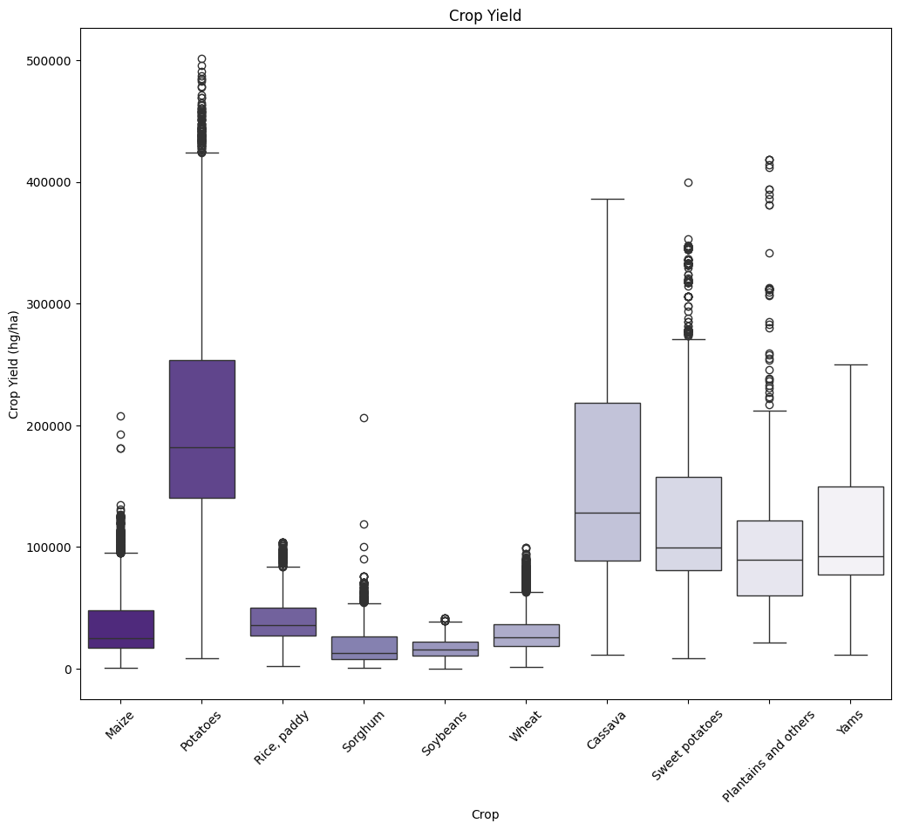
Box Plot

Slide 16
Conclusion
Knowing how weather affects crop yield can help consumers policy makers and farmers all gain important insights.With the use of this data farmers will be able to make well-informed choices on crop selection , planting dates, irrigation plans and pest control techniques.Using this information any one create agricultural policies and support initiatives that effectively reduce the negative effects of unfavourable weather occurences on crop productivity and food security.As agricultural productivity is maximised consumers may benefit from more consistent food supply higher quality produce and maybe lower pricing.In general, the examination of the yield_df dataset's weather crop yield connections helps both agricultural stakeholders and the larger objective of guaranteeing food security and sustainbility for the general public.

